Slide 1

DEPARTMENT OF AI&DS ENGINEERING DR. D. Y. PATIL INSTITUTE OF TECHNOLOGY, PIMPRI, PUNE
Project Based Learning II (217533)
Second Year (B.E.-AI&DS)
Health Genie – A Disease Prediction and monitoring System
Under the Guidance of
Prof. Jyotsna Barpute
Department of AI&DS,
Dr. D. Y. Patil Institute of Technology,
Pimpri, Pune-411018.
Presented By
Sakshi, Zuber, Shruti (59,63,75)
Department of AI&DS,
Dr. D. Y. Patil Institute of Technology,
Pimpri, Pune-411018.

Slide 2
TABLE OF CONTENTS
01 Domain
02 Brief Introduction
03 Motivation: Need, Relevance and Scope
04 Literature Survey
05 Aim and Objective
06 Proposed architecture / Methodology
07 Proposed Algorithm
08 Block Diagram
09 Software and Hardware requirements
10 Advantages
11 Limitations
12 Application
13 Future Scope
14 Conclusion
15 References

Slide 3
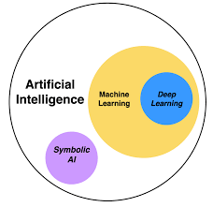
DOMAIN:
01
Machine Learning -
Certainly! Machine learning is a way for computers to learn and make decisions without being explicitly programmed.
Instead of giving the computer specific instructions, you provide it with data and algorithms that allow it to identify patterns and learn from them.
It's like teaching a computer to recognize and understand information on its own, so it can make predictions or decisions based on new, unseen data. In simple terms, it's a way for machines to learn from experience and improve their performance over time.

Slide 4
Brief Introduction
02
A one stop solution for health related problems.
Features-
Disease Prediction
Diseases checker for some severe diseases like
- Diabetes
- Health Related Issues(Cardiovasular Diseases)
- Lung Cancer
- Predicting the diseases by analyzing CT- SCAN

Slide 5
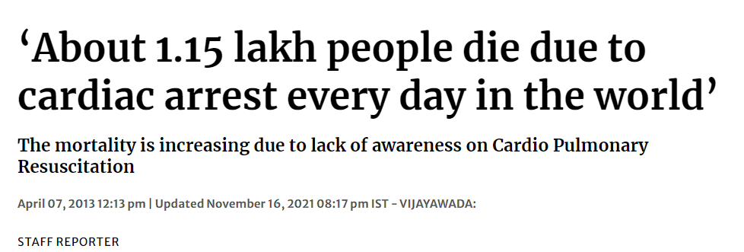
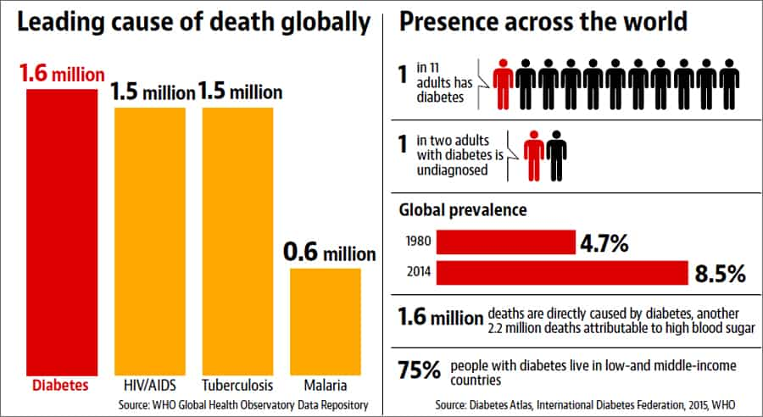
Motivation : Need, Relevance and Scope
03
Is it really needed?

Slide 6
SCOPE
Early detection of diseases is crucial for effective treatment
Remote Access to Healthcare
Providing individuals with information about their health empowers them to actively participate in their well-being.
Preventive Healthcare

Slide 7

04
LITERATURE SURVEY

Slide 8
Sr.no | Title of the Research Paper | Name of the Author | Year of publication | Methodology | Advantages | Disadvantages | Future Scope
1. | Machine learning-based method for personalized and cost-effective detection of Alzheimer's disease | Mahmoud M.Abdelwah Khamis A. Al-Karawi and Hatem E. Semary | 2023 Dec; 11(12): 3304 |  | 1. Early Detection 2. Personalized Medicine 3. Cost Efficiency 4. Data-Driven Insights 5. Improved Accuracy | - Data Quality and Availability - Cost of Implementation - Patient Privacy and Consent
Summary: The main objective of this paper is to supply scientific basics for preventing and forecasting the prevalence of hand, foot and mouth.

Slide 9
Sr.no | Title of the Research Paper | Name of the Author | Year of publication | Methodology | Advantages | Disadvantages | Future Scope
2. | Quantized Analysis for Heart Valve Disease based on Cardiac Sound Characteristic | Hu Yuliang; Qiao Junxuan; Wang Haibin; Wei Xiubo | 23 August 2010 |  | In order to analyze heart valve disease accurately and effectively | -Loss of Information -Reduced Sensitivity -Limited Dynamic Range -Introduction of Quantization Noise
Summary: Analytical model of single degree-offreedomwas established to extract characteristic waveform.

Slide 10
05
AIM AND OBJECTIVE
Aim of the Project:
Implement advanced data analytics and machine learning algorithms to continuously monitor health parameters, identify patterns, and predict potential health risks and diseases.
Enable personalized health insights by considering individual health histories, genetic information, and lifestyle factors, providing users with actionable recommendations for preventive measures and lifestyle modifications.

Slide 11
06
PROPOSED ARCHITECTURE / METHADOLOGY
Data Collection:
Preprocessing:
Gather a comprehensive dataset containing symptoms and associated diseases for training the machine learning model. This dataset should be diverse, covering a wide range of medical conditions.
Clean and preprocess the dataset to handle missing values, standardize formats, and ensure data quality. Perform feature engineering to extract relevant information from the symptoms and diseases.

Slide 12
Machine Learning Model Training:
Validation and Testing:
Educational Component:
Utilize machine learning algorithms, such as decision trees, random forests, or neural networks, to train the predictive model. Train the model on the preprocessed dataset, allowing it to learn patterns and relationships between symptoms and diseases.
Split the dataset into training and testing sets for model validation. Assess the model's performance on the testing set to ensure its ability to generalize to new, unseen data
Include an educational component within the user interface to provide information on how the prediction model works. This component should enhance health literacy, helping users understand the rationale behind the predictions and promoting informed healthcare decisions.

Slide 13
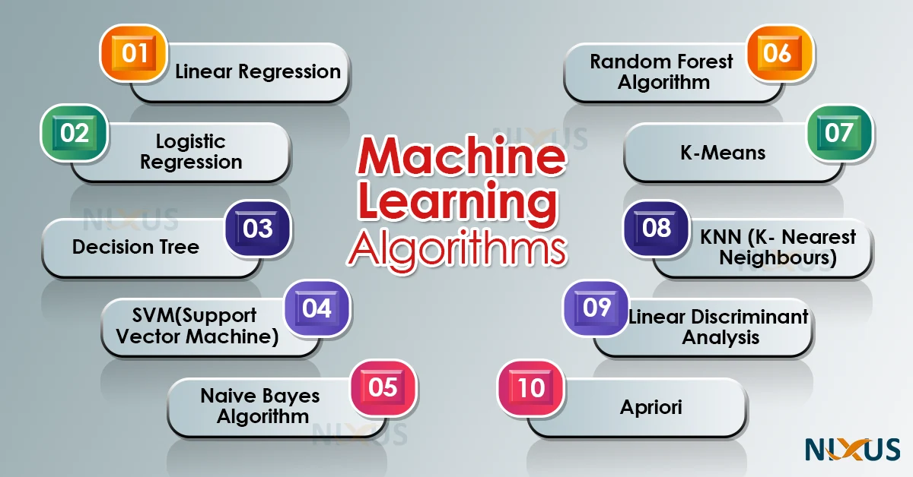
07
PROPOSED ALGORITHM

Slide 14
Algorithms Used
1. Decision Trees:
- Decision Trees are a non-parametric supervised learning method used for classification and regression.
- They partition the data into subsets based on the values of input features.
- Decision Trees are easy to interpret and can handle both numerical and categorical data.
2. Random Forest:
Random Forest is an ensemble learning method that constructs a multitude of decision trees at training time and outputs the mode of the classes (classification) or mean prediction (regression) of the individual trees.
It improves the accuracy of the model and reduces overfitting compared to a single decision tree.

Slide 15
08
Load the dataset for disease prediction
Identifying the File Format
Convering the json fike to csv if any
Separate features (x) and target (y)
Features (X): Features represent the input variables or attributes.
Get user input
The preprocessed and formatted data is fed into the trained machine learning model
And Predicted result is shown
Predict and give the result
Training with particular algorithm classifier
Target (y): The target variable, is the variable we want to predict based on the input features.
Prompting the User
Reading Input
Processing Input
Feedback or Response
Linear Regression
Logistic Regression
Decision Trees
Random Forest
Support Vector Machines (SVM)
BLOCK DIAGRAM

Slide 16
09
SOFTWARE AND HARDWARE REQUIREMENTS
Software
Operating System
Programming Languages(Python, HTML,CSS)
Anaconda- Anaconda distribution is a free and open-source platform for Python language.
Hardware
CPU and Memory( Min. 8gb RAM and 256ssd)
Adequate bandwidth and network
Storage
IDE (Integrated Development Environment
Backup and Redundancy

Slide 17
10
ADVANTAGES
Early Disease Detection: By analyzing symptoms provided by the user, Health Genie can predict potential diseases at an early stage. This early detection allows for timely intervention and treatment, potentially preventing the progression of the disease to more severe stages.
Convenience: Health Genie provides a convenient way for users to assess their health status without the need for physical appointments. Users can access the platform from their own devices, saving time and effort typically associated with traditional medical consultations.
Accessibility: The platform increases accessibility to healthcare services, particularly for individuals in remote or underserved areas who may have limited access to medical facilities. As long as users have internet access, they can utilize Health Genie to assess their health status.

Slide 18
Data-driven Insights: By analyzing large amounts of health data, Health Genie can provide valuable insights into trends and patterns related to various diseases. These insights can contribute to medical research and public health initiatives aimed at improving disease prevention and management strategies.

Slide 19
11
LIMITATIONS
Accuracy Limitations: The accuracy of disease predictions and risk assessments may vary based on the quality of input data, the complexity of the algorithms used, and the limitations of current medical knowledge
Lack of Human Interaction: Health Genie lacks the human element of traditional medical consultations, including the ability to ask clarifying questions, provide emotional support, or conduct physical examinations.
Privacy Concerns: Users may have concerns about the privacy and security of their health data when using an online platform like Health Genie. Unauthorized access, data breaches, or misuse of personal information could lead to privacy violations and undermine user trust.
Dependency on Technology: Relying solely on technology for health assessments could lead to a dependency on devices or internet connectivity. Users in areas with poor internet access or limited technological literacy may face barriers to accessing and utilizing Health Genie effectively

Slide 20
12
APPLICATION
Disease Prediction and Prevention
Remote Patient Monitoring
Employee Health and Wellness Programs
Health Education and Awareness(Educational Tool)
Personal Health Management

Slide 21
13
FUTURE SCOPE
Integration of Wearable Devices
Health Genie could integrate with wearable devices such as fitness trackers, smartwatches, and medical sensors to collect real-time health data.
Telemedicine Innovation
could incorporate innovative telemedicine features such as virtual reality consultations, remote diagnostic imaging, and tele-surgery capabilities. These advancements would enhance the platform's utility for remote healthcare delivery.
Partnerships with Healthcare Ecosystem Stakeholders
Health Genie could form strategic partnerships with healthcare providers, insurance companies, pharmaceutical firms, academic institutions, and government agencies to create a comprehensive healthcare ecosystem

Slide 22
14
CONCLUSION
Health – Genie (A disease and health monitoring platform)
Capable of predicting the risk of some severe diseases
like – Diabetes
Cardiovascular diseases(Heart Issues)
Lung Cancer
-Do we really need any platform like this?
Yes, its needed!!!
Helps in –
Early disease detection
Preventive health care and treatment
Accessibility in the rural areas(Areas with bare min health care facilities)

Slide 23
15
REFERENCES
[1] THE HINDU Article - RAMYA KANAAN
“Explained | How can India tackle its diabetes burden?
,” June 18, 2023 04:30 am | Updated 12:55 pm IST.
[2]THE TIMES OF INDIA – Richa Gandhi
“Rising diabetes curve: A warning for India
,” Nov 14 2023, 6:30 IST.
[3] Hu Yuliang; Qiao Junxuan; Wang Haibin; Wei Xiubo,
“Machine Learning-Based Method for Personalized and Cost-Effective Detection of Alzheimer's Disease,”
Date Added to IEEE Xplore: 23 August 2010.

Slide 24
THANK YOU

